Slide 1
Finn Family Moomintroll
By Tove Jansson

Slide 2
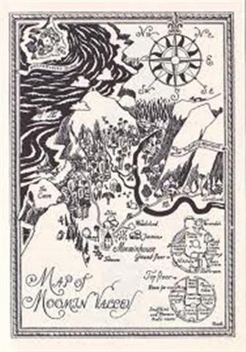
Moomin Valley

Slide 3
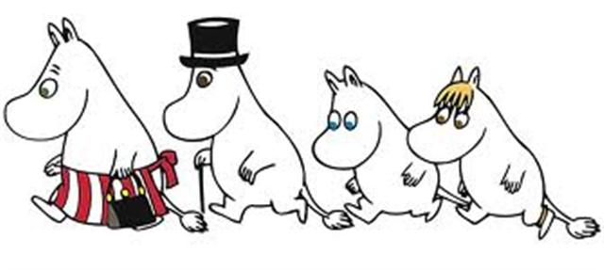
The Moomins: Mamma, Pappa, Moomintroll, Snorkmaiden

Slide 4
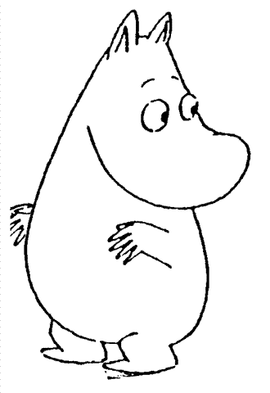
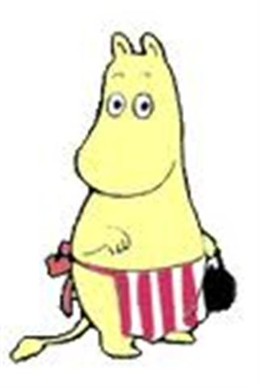
Preface
The snow has come!
I know. Your beds are made.

Slide 5
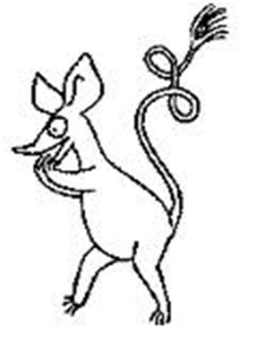
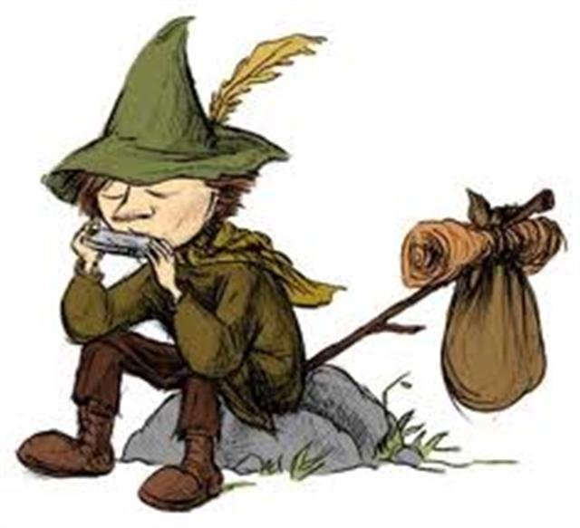
It is Winter
Sniff
Snufkin

Slide 6
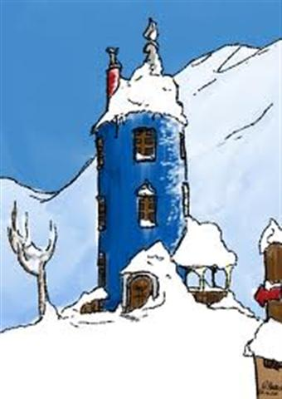
Winter has come

